Slide 1

Python for Data Science
PYTHON + PANDAS

Slide 2

What is Pandas — and Why Does It Matter?
Pandas is a Python library for working with tabular data — like spreadsheets, but far more powerful. Think of it as Excel on steroids, built for real-world data science.
🐼 Pandas
📊 Excel
📦 Python Lists
Handles millions of rows, automates cleaning, and connects to databases and code.
Great for small tasks, but struggles with large datasets and can't be automated easily.
Basic containers with no labels, no math, and no built-in data tools.
💡 Install & Import: Run pip install pandas in your terminal, then write import pandas as pd in your code. The alias pd is the universal standard — you'll see it in every tutorial and workplace project.
Pandas does everything Excel does, pandas can handle millions of rows without crashing, can be automated with code, and integrates with the full Python ecosystem. The "pd" alias is just a shortcut — like calling a friend by their nickname instead of their full name.

Slide 3
Understanding Datasets
A dataset is a collection of data.
In Pandas:
Stored as a DataFrame , Looks like a table:
Example:
import pandas as pd
data = {
"Name": ["A", "B", "C"],
"Age": [20, 25, 30],
"Salary": [20000, 30000, 40000]
}
df = pd.DataFrame(data)
print(df)
            Output:
            Name Age Salary
            0 A 20 20000
            1 B 25 30000
            2 C 30 40000
                Key components:
                Rows → records
                Columns → features
                Index → row labels

Slide 4
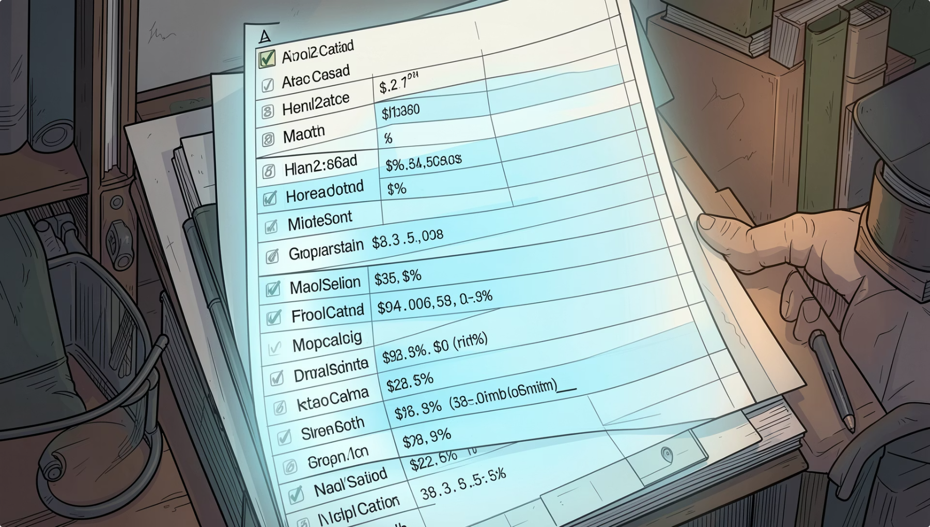


Series: Your First Pandas Structure
What is a Series?
A Series is a one-dimensional labeled list — like a single column in a spreadsheet. Every value has an index (a label) that helps you find it.
import pandas as pd
# Create a Series from a list
scores = pd.Series([85, 90, 78, 92],
index=["Alice","Bob","Cara","Dan"])
print(scores)
print(scores["Bob"]) # Output: 90
Output:
Alice 85
Bob 90
Cara 78
Dan 92
⚠️ Beginner Mistake: Forgetting import pandas as pd before creating a Series will cause a NameError.
A Series is like one column in Excel — it holds values and each value has a label (the index). You can create it from a list, tuple, or dictionary. If you don't provide an index, Pandas assigns numbers 0, 1, 2... automatically. You can do math on Series (add, multiply) and filter them just like in later lessons. Try creating one with student names and test scores!

Slide 5
Creating Series :
A) Creating Series from List
import pandas as pd
data = [10, 20, 30, 40]
s = pd.Series(data)
print(s)
Output
0 10
1 20
2 30
3 40
dtype: int64
B) Creating Series from Tuple
import pandas as pd
data = (5, 10, 15)
s = pd.Series(data)
print(s)
Output
0 5
1 10
2 15
dtype: int64
C) Creating Series from Dictionary
import pandas as pd
data = {
"Math": 90,
"Science": 85,
"English": 88
}
s = pd.Series(data)
print(s)
Output
Math 90
Science 85
English 88
dtype: int64

Slide 6
Operations on Series:
Pandas allows direct operations on Series.
Mathematical Operations
Filtering Data in Series
Filtering means selecting data based on conditions.
Example: Filter Values Greater Than 50
import pandas as pd
s = pd.Series([20, 55, 70, 15])
print(s[s > 50])
Output
1 55
2 70
dtype: int64
Addition
import pandas as pd
s = pd.Series([1, 2, 3])
print(s + 5)
Output
0 6
1 7
2 8
dtype: int64
Multiplication
import pandas as pd
s = pd.Series([2, 4, 6])
print(s * 2)
Output
0 4
1 8
2 12
dtype: int64
Finding Mean
import pandas as pd
s = pd.Series([10, 20, 30, 40])
print(s.mean())
Output
25.0

Slide 7
Indexing in Series:
Indexes are labels assigned to values.
Default indexes start from 0.
You can also create custom indexes.
Access Using Custom Index
import pandas as pd
s = pd.Series([100, 200, 300], index=["x", "y", "z"])
print(s["y"])
Output
200
Custom Index
import pandas as pd
data = [100, 200, 300]
s = pd.Series(data, index=["A", "B", "C"])
print(s)
Output
A 100
B 200
C 300
dtype: int64
Accessing Elements
Access Using Default Index
import pandas as pd
s = pd.Series([10, 20, 30])
print(s[1])
Output
20
Changing Index Names
import pandas as pd
s = pd.Series([10, 20, 30])
s.index = ["A", "B", "C"]
print(s)
Output
A 10
B 20
C 30
dtype: int64

Slide 8

DataFrame: The Heart of Pandas
What is a DataFrame?
Key Attributes
A DataFrame is a 2D table — rows and columns — like a spreadsheet or SQL table. It's the main structure you'll work with in Pandas.
df.shape
df.dtypes
Returns (rows, columns) — e.g., (3, 3)
Data type of each column (int, float, object)
import pandas as pd
students = {
"Name": ["Alice","Bob","Cara"],
"Age": [20, 21, 19],
"Score": [85, 90, 78]
}
df = pd.DataFrame(students)
print(df)
df.info()
df.describe()
Summary: rows, columns, data types, memory usage
Statistics: count, mean, min, max for numeric columns
Output:
Name Age Score
0 Alice 20 85
1 Bob 21 90
2 Cara 19 78
The DataFrame is the most important structure in Pandas — think of it as a full spreadsheet in your code. You can create it from a dictionary (keys become column names), a list of lists, or load it from a CSV file. The attributes like .shape and .dtypes help you understand your data at a glance. Run df.info() first whenever you load a new dataset — it's your data's ID card.

Slide 9
Rows and Columns:-
Pandas allows direct operations on Series.
Rows
Horizontal entries
Represent records/data entries
Example:
One student’s information
Columns
Vertical entries
Represent attributes/features
Example:
Name
Age
Marks
Here:
Rows = Students
Columns = Name, Age, Marks
Creating DataFrame from CSV File
CSV = Comma Separated Values
Example CSV file (students.csv):
Name,Age,Marks
Ravi,20,85
Anu,21,90
Kiran,22,78
Reading CSV File
import pandas as pd
df = pd.read_csv("students.csv")
print(df)
Output
Name Age Marks
0 Ravi 20 85
1 Anu 21 90
2 Kiran 22 78
Creating DataFrame from Dictionary
import pandas as pd
data = {
"Name": ["Ravi", "Anu", "Kiran"],
"Age": [20, 21, 22],
"Marks": [85, 90, 78]
}
df = pd.DataFrame(data)
print(df)
Output
Name Age Marks
0 Ravi 20 85
1 Anu 21 90
2 Kiran 22 78
Creating DataFrame from List
Using List of Lists
import pandas as pd
data = [
["Ravi", 20, 85],
["Anu", 21, 90],
["Kiran", 22, 78]
]
df = pd.DataFrame(data, columns=
["Name", "Age", "Marks"])
print(df)
Output
Name Age Marks
0 Ravi 20 85
1 Anu 21 90
2 Kiran 22 78
Using List of Dictionaries
import pandas as pd
data = [
{"Name": "Ravi", "Age": 20},
{"Name": "Anu", "Age": 21}
]
df = pd.DataFrame(data)
print(df)
Output
Name Age
0 Ravi 20
1 Anu 21

Slide 10


Viewing & Selecting Data
Peek at Your Data
Select with loc[]
Select with iloc[]
df.head() shows the first 5 rows. df.tail() shows the last 5. df.sample() picks random rows. Always start here after loading a file!
Selects by label (row/column names). Example: df.loc[0, "Name"] returns the value at row label 0, column "Name".
Selects by integer position. Example: df.iloc[0, 1] returns the value at the first row, second column — always by number.
⚠️ loc vs iloc: loc[] uses names; iloc[] uses positions. Mixing them up is the #1 beginner error in Pandas!
Before doing anything with a dataset, always we have to run .head() to see what you're working with. The loc/iloc distinction is critical — loc uses labels (like row names), iloc uses positions (like 0, 1, 2). A helpful memory trick: "iloc" has an "i" for integer. Common mistake: using df["Name"][0] which can give warnings — prefer .loc[] or .iloc[] instead.

Slide 11


Reading, Writing & Sorting Data
Load & Save Files
Sort Your Data
# Read a CSV file
df = pd.read_csv("students.csv")
# Read an Excel file
df = pd.read_excel("data.xlsx")
# Save to CSV
df.to_csv("output.csv", index=False)
# Save to Excel
df.to_excel("report.xlsx")
# Sort by Score (high to low)
df.sort_values("Score",
ascending=False)
# Sort by multiple columns
df.sort_values(["Age","Score"],
ascending=[True, False])
Sorting helps you quickly find top performers, oldest records, or any ranked view of your data.
⚠️ Common Error: FileNotFoundError means your file path is wrong. Use forward slashes / or raw strings r"path\file.csv".
pd.read_csv() is the most common way to load data — it's like opening a file in Excel, but in code. Always check your file path carefully; a typo causes FileNotFoundError. The index=False in to_csv() prevents Pandas from saving the row numbers as an extra column. For sorting, ascending=False means highest values first — think "descending order." Try sorting a student dataset by test scores to find the top performers!

Slide 12

Filtering Data 🔍
Boolean Conditions
Filter rows by writing conditions. Pandas returns only the rows where the condition is True.
# Students with Score above 85
df[df["Score"] > 85]
# AND: Age over 20 AND Score above 85
df[(df["Age"] > 20) &
(df["Score"] > 85)]
# OR: Score above 90 OR below 70
df[(df["Score"] > 90) |
(df["Score"] < 70)]
💡 Use & for AND, | for OR. Always wrap each condition in parentheses ().
Filtering is like using a filter in Excel — you tell Pandas which rows to keep. The & symbol means AND (both conditions must be true), and | means OR (either condition can be true). The most common beginner mistake is forgetting parentheses around each condition — Python's order of operations will give you an error without them. Try filtering a student dataset to find everyone who scored above 80!

Slide 13
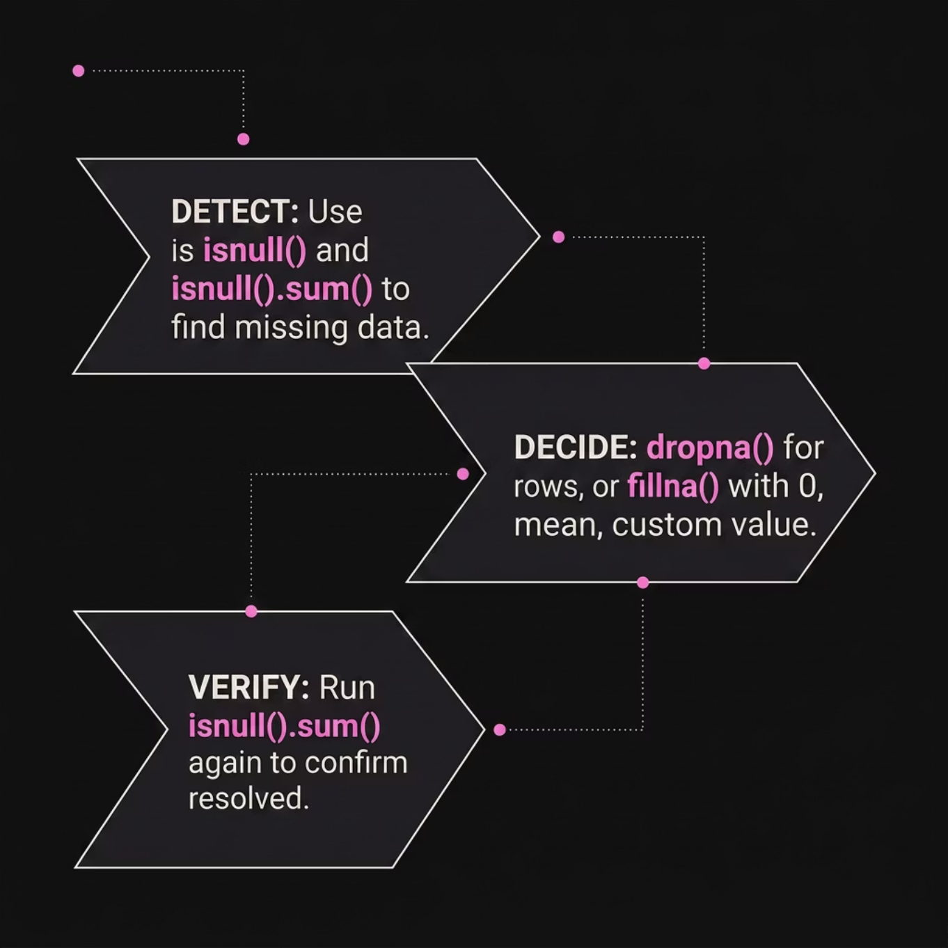

Handling Missing Values
Why Does Data Go Missing?
Missing values (NaN) happen when data wasn't recorded, was deleted, or came from an incomplete source. Always check before analyzing!
# Find missing values
df.isnull() # True/False per cell
df.isnull().sum() # Count per column
# Drop rows with any missing value
df.dropna()
# Fill missing values
df.fillna(0) # Replace with 0
df.fillna(df.mean()) # Replace with average
Missing data is one of the most common real-world problems. In a hospital dataset, a patient's age might be blank; in a student dataset, a test score might be missing. Never ignore NaN values — they break calculations. Use isnull().sum() first to see how many missing values exist per column. If only a few rows are affected, drop them. If many, fill with a reasonable value like the column average. Always verify with isnull().sum() again after cleaning.

Slide 14
GroupBy, Merge & Transform
groupby() + agg()
merge() — Joins
apply() + Lambda
Split data into groups, then calculate stats per group.
Combine two DataFrames like SQL joins.
Run a custom function on every row or column.
df.groupby("Class")["Score"].agg(
["mean","max","min"])
pd.merge(df1, df2,
on="StudentID",
how="left") # left, inner, right, outer
df["Grade"] = df["Score"].apply(
lambda x: "Pass" if x>=60 else "Fail")
groupby() is like a Pivot Table in Excel — it groups rows by a category (like Class) and calculates stats for each group. merge() combines two tables using a shared key column, just like VLOOKUP in Excel or JOIN in SQL. apply() lets you write custom logic — the lambda is a tiny one-line function. These three tools together let you summarize, combine, and transform any dataset.

Slide 15


Example: Student Data Analysis
Put It All Together
Load a student dataset, clean it, filter, group, and find insights — using everything you've learned!
import pandas as pd
df = pd.read_csv("students.csv")
df = df.dropna()
passed = df[df["Score"] >= 60]
summary = df.groupby("Class")["Score"].mean()
print(summary)
Output:
Class
A 84.5
B 78.2
C 81.0
🎯 Key Insight: Class A has the highest average score — great starting point for deeper analysis!
The core skills: loading data with read_csv(), cleaning with dropna(), filtering with a boolean condition, and summarizing with groupby().

Slide 16
Final Summary
Recap Core Concepts
Pandas: The Data Backbone
We've explored Series and DataFrames, mastering data selection, loading, saving, filtering, and cleaning. Key operations like GroupBy and Merge unlock powerful data transformation.
Pandas is the fundamental library for data manipulation in Python. It's the essential tool for preparing, understanding, and extracting value from structured datasets across all industries.
Career Applications
Your Next Steps
Proficiency in Pandas is a core requirement for roles like Data Analyst, Data Scientist, Business Intelligence Developer, and Machine Learning Engineer. It's your gateway to data-driven careers.
Continue practicing with diverse datasets. Explore advanced Pandas features, delve into data visualization (Matplotlib, Seaborn), and tackle larger projects to solidify your skills.

Slide 17
Pandas Cheatsheet: Essential Commands
A quick reference guide to the most important Pandas functions and concepts covered in this presentation.
1
2
FUNDAMENTALS
ACCESS & I/O
Structures & Inspection
Selection & Data IO
pd.Series(): 1D labeled array.
pd.DataFrame(): 2D labeled table.
df.head()/.tail(): View top/bottom rows.
df.info(): Summary of DataFrame.
df.describe(): Statistical summary.
df['Col']: Select column.
df.loc[]: Label-based selection.
df.iloc[]: Integer-based selection.
pd.read_csv(): Load data.
df.to_csv(): Save data.
df.sort_values(): Order data by columns.
3
4
CLEAN & FILTER
TRANSFORMATIONS
Missing Data & Filtering
Group, Merge & Apply
df.isnull().sum(): Count missing values.
df.dropna(): Remove rows with NaN.
df.fillna(): Replace NaN values.
df[condition]: Filter rows.
& (AND), | (OR) for complex filters.
df.groupby(): Aggregate by groups.
df.agg(): Apply multiple functions.
pd.merge(): Combine DataFrames.
df.apply(): Custom row/column operations.
lambda: Anonymous functions.

